Slide 1
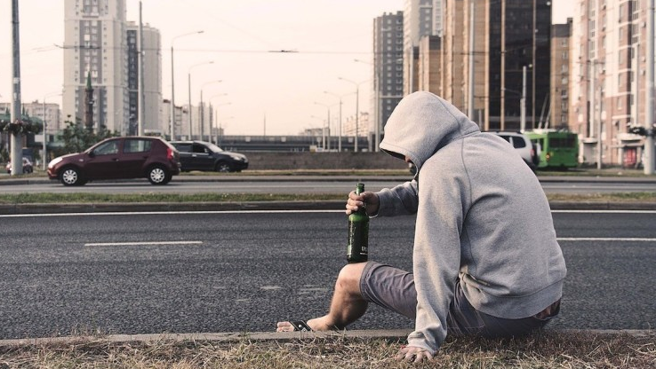

Los Angeles
Drinking x Crime
by
The Harmonious Hummingbirds
Andrew Wright
Jennie Chang
Leo Ramirez
Raymond Barry
Sanaz Shahbazian
Toshe Ayo-Ariyo

Slide 2
Purpose
XYZ

Slide 3
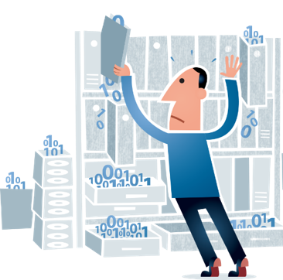

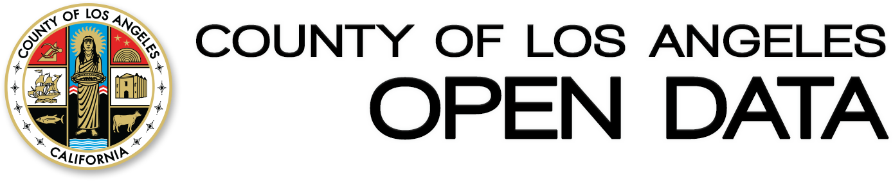
DATA
SOURCES
X
Los Angeles County Crime API (2016-2019)

Slide 4
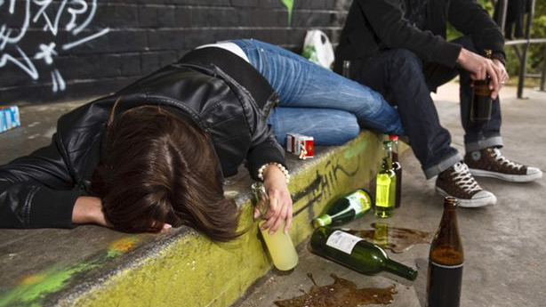
DEFINTION OF
Drunken Arrests
Crimes that include the following keywords:
Drunk
Drinking
Alcohol
DUI
Intoxication

Slide 5
How does drunk-related arrests rank amongst different types of crime in LA?

Slide 6
How does drunk-related arrests rank amongst different types of crime in LA?

Slide 7
Where are the top visited bars in Los Angeles?

Slide 8
Where are the most arrests for public intoxication happening?

Slide 9
Proximity of drunken arrests to top 100 reviewed bars in LA

Slide 10
Is there a correlation of drunken arrests to $ - $$ bars vs $$$-$$$$ bars?

Slide 11

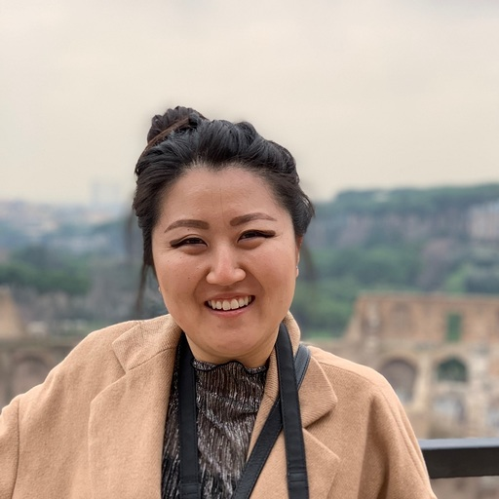
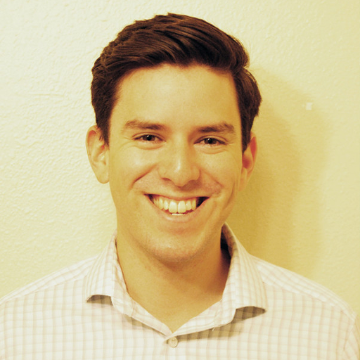

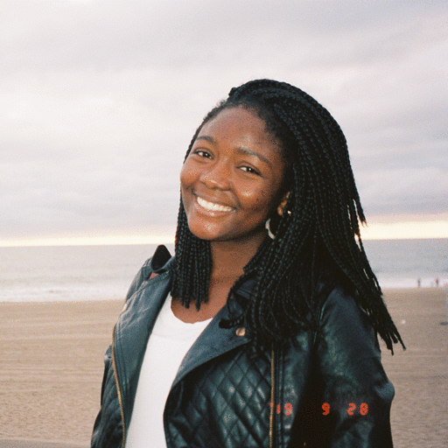

The Team
Andrew Wright
901 Bar & Grill
Jennie Chang
The Figueroa Hotel
Leo Ramirez
The Blind Donkey
Raymond Barry
The Venice Room
Toshe Ayo-Ariyo
Perch
Sanaz Shahbazian
xyz

